Slide 1



Respiratory Sinus Arrythmia
Using the same google doc as last week, continue by adding the header “Lab 2: RSA”
Paste from the “hypothesis and data” file from the D2L In-Class folder into your team google doc
“No prizefighter can go with high spirits into the strife if he has never been beaten black and blue, the only contestant who can confidently enter the lists is the man who has seen his own blood, who has felt his teeth rattle beneath his opponent’s fist, who has been tripped and felt the full force of his adversary’s charge, who has been downed in body but not in spirit, one who, as often as he falls, rises again with greater defiance than ever.” -Seneca
Notes:
Review “to do” list
Reveal the mindtrap question

Slide 2
Typical Routine
Prep:
Prelab video, quiz, and reading
In class:
Attendance poll
Physiology in the News presentation
Announcements
Brief TA lecture, if needed
Hypotheses activity and check off with instructor
Data Analysis
Figure Legend and Data Check off with instructor
Lab Activity
After class:
Weekly reading and homework completed after class
Due before the start of class the following week

Slide 3
In Class Procedure
Copy “hypothesis and data” form on D2L to your google doc
Four parts checked off by instructor (call your TA from the breakout room when ready)
Hypothesis (20 pts)
Data will be released to you after check off by instructor pasting into your google doc
Screen Captures Figure Legends (10 pts)
Data Analysis/Graphs (15 pts)
Other In Class Activity, if pertinent (10 pts)
Notes:
Add professionalism point

Slide 4
Weekly check off points
 | Exceptional |  | Good |  | Needs Work | Incomplete
Hypotheses | 20 | 19 | 18 | 17 | 16 | 0
Screen Captures Figure Legends | 10 | 9.5 | 9 | 8.5 | 8 | 0
Data Analysis/Graphs | 15 | 14.5 | 14 | 13.5 | 13 | 0
Activity | 10 | 9.5 | 9 | 8.5 | 8 | 0
Professionalism Point | Potential deductions for lack of engagement or unprofessional behavior
Notes:
Add first and last name of group members when arriving at class
All get full credit this week as a learning experience but will get marked as earned points

Slide 5
Post-lab weekly assignments
Must be in your own words
Use word file, keep prompts, and type answers under the prompt
USE POSTED PAPERS THAT ARE DESIGNED SPECIFICALLY FOR THE QUESTIONS WITH TARGETED READING SECTIONS:
Goal time for homework (total time with reading and writing) should be less than 4 hours outside of class for a 2 credit Capstone Lab course
Tips on answering experimental design questions each week
Notes:
Go over example lab report key and example experiment question

Slide 6
How well did you learn stats? 1. Informal self-quiz 2. Useful stats handout (in class activity of the week)
Notes:
Give the normal stats quiz about matching the stats test to the experimental design in D2L indivually
Group activity to complete the worksheet
TA go over answers to both

Slide 7
Weekly experimental questions
How would you predict heart rate is altered during each inspiration and expiration?
How would you predict the maximum to minimum range of heart rates observed during respiratory sinus arrhythmia at baseline will change with deep breathing?
Notes:
Each week we will address experimental questions that are presented at the start of lecture and again before stating the experiment

Slide 8
Weekly Stats: Paired T-Test
We will provide you with the class data graph and stats results each week
Paired t-test
T-test: Used when comparing two conditions
Baseline Control vs Deep Breathing (independent variable)
Paired: Same subject perform the test in both conditions
Notes:
No additional comments

Slide 9
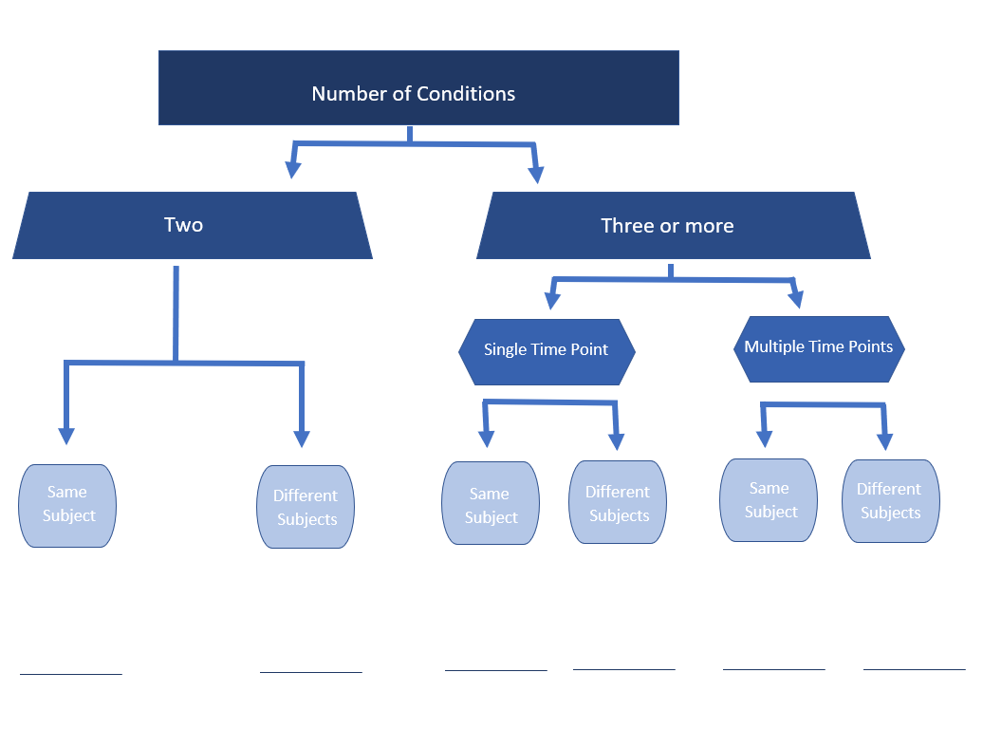
Paired T-test

Slide 10
Writing a good hypothesis and justification
Educated prediction about the direction of the change that what will happen
Use your notes, resources, knowledge, preliminary data, lab manual to inform and justify your response
Testable
Must be able to measure:
What you do
Slow deep breathing respiratory pattern with belt
What will happen
Pulse frequency measurement
Independent and dependent variable
Independent: What I will change
Breathing pattern
Dependent: What I observe
Heart rate via pulse transducer
Notes:
Give tips for writing the first hypothesis next week

Slide 11
Example of hypothesis with justification
Space flight will decrease leg muscle mass….
Space flight - independent (what we changed)
Muscle mass – dependent (what we observe in response to the change)
…because microgravity environments limit weight bearing activities like walking and when there is a lack of muscle work the muscle fibers will atrophy.
Physiological rationale for your predication
Notes:
For full check off need prediction direction of change and rationale

Slide 12
Weekly experimental questions
How would you predict heart rate is altered during each inspiration and expiration?
How would you predict the maximum to minimum range of heart rates observed during respiratory sinus arrhythmia at baseline will change with deep breathing?
Notes:
Each week we will address experimental questions that are presented at the start of lecture and again before stating the experiment

Slide 13
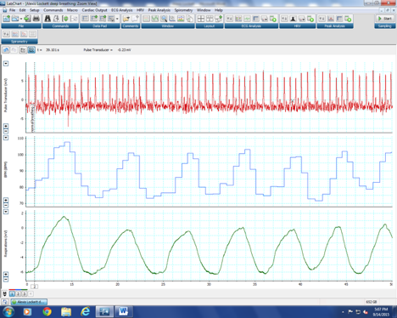
Screen Captures and Figures Legends
Be sure you understand what device is being displayed and what body function is being assessed for each channel
Review from the prelab lecture and readings

Slide 14
Note on graphs and homework
As we do the interpretation of the graph and stats in class this will help you on the first part of the homework!
Remaining time in class, if available, should be used to work on homework with your group and get assistance from your TA
We will keep zoom open the full class period for “open lab” if there is time remaining

